Slide 1
Drawing
Group 4
Gabrielle V.
Sydney S.
Isabella Q.
Lilia S.
Julia L.
Timothy D.
Angel L.
Anticipatory Set
When students first walk into class, there will be different colored pieces of gray paper on their desks.
Their task will be to line up from white, to darker grays, and end with black.
This would be good as a kinesthetic activity to get the students moving and bring excitement from their curiosity.
This will be a segway into value.
I

Slide 2
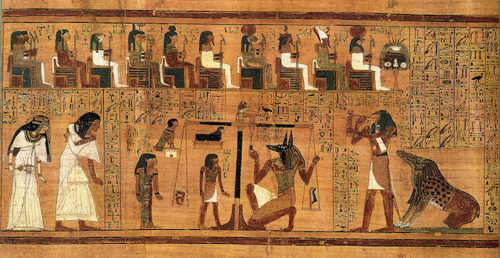
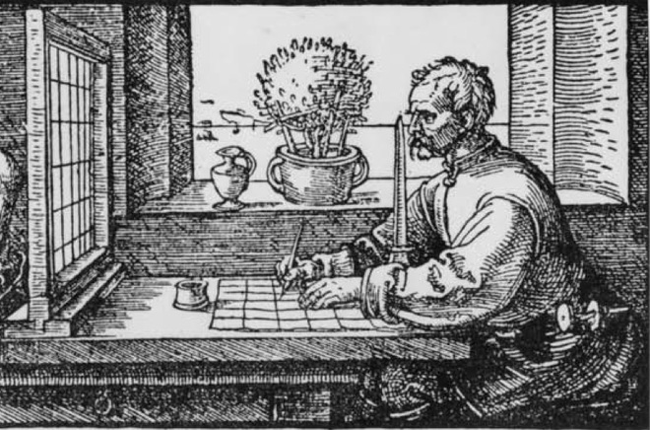
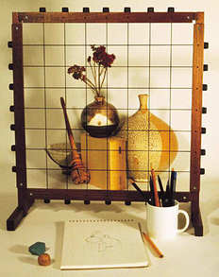
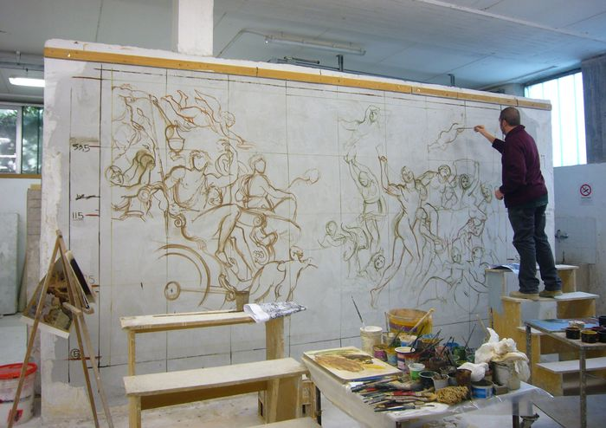
Egyptians
History of the Grid:
The Grid Method in Use
Art History Lesson
Master craftsmen would first sketch out the artwork and used a method called ‘snapping,’ a string soaked in red dye create a grid on top of the work.
A large wall would be then gridded to easily transfer the sketch onto the wall. Creating the large-scaled artworks we see today.
Throughout history many famous artists have used the Grid Method for drawing including Leonardo Da Vinci, Albrecht Durer, Vincent Van Gogh.
The grid method has been utilized by artist since ancient times. While there is no exact date, the earliest example of the grid can be see in Ancient Egyptian artworks.
Renaissance
A grid allows the artist to draw what they see by sectioning their subject into smaller units which correspond to similar units on their artwork.
Artists used the grid as a means to achieve an accurate drawing.
It was also a way to easily scale up smaller sketches onto larger surfaces, which can be seen in Frescos.
The Renaissance artists used the grid method a bit differently in their works.
Using a wooden frame, they would hammer in nails spaced equally apart and tie lengths of string from one end to the other to create their rows and columns.
The the frame would be placed in front of the model or painting subject so they could look through the grid.
J

Slide 3
Essential Questions
Why do people value objects, artifacts, and artworks and select them for presentation?
How do objects, places, and design shape lives and communities?
How can planning out our art be an advantage?
How can self-identity influence the work we make?
Big Idea
What is self-identity?
How can we represent identity?
What are the objects, places, people, memories that make you who you are today?
A

Slide 4
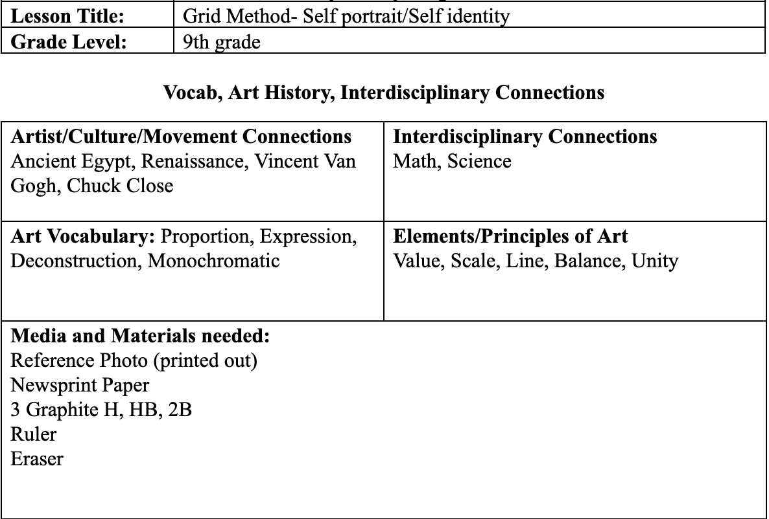
Lesson Plan: Scaled Identity Portrait Drawing
Learning Objectives
1. Students will choose an image to express their present self-identity
2.Students will analyze their choice and reflect on how they see the world
3.Students will go from a smaller scale exercise to a final product and note improvement. Taking everything they’ve learned along the way and implementing that knowledge and practice on the final project
Content Standards
CREATING
Prof.VA:Cr1: Use multiple approaches to begin creative endeavors.
RESPONDING
Prof.VA:Re7.2: Analyze how one’s understanding of the world is affected by experiencing visual imagery.
CONNECTING
Prof.VA:Cn10: Document the process of idea development from early-stage ideas to fully elaborated ideas.
Prof.VA:Cn11: Describe how knowledge of culture, traditions, and history may influence personal responses to art.
G

Slide 5
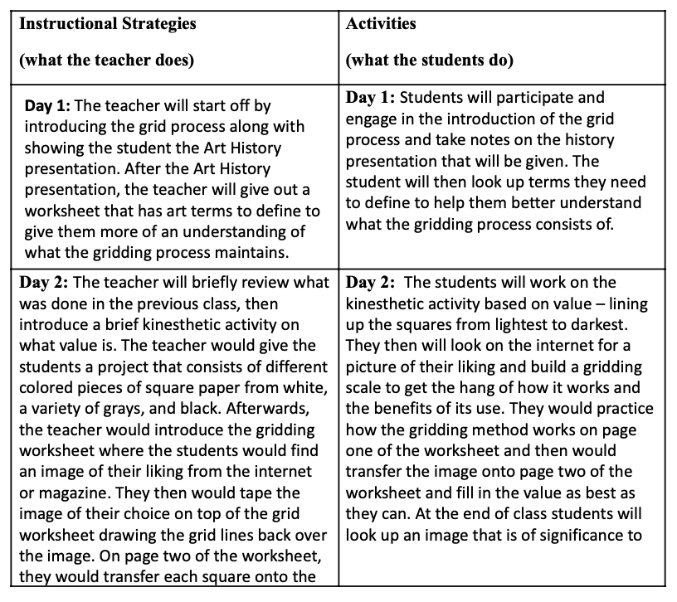
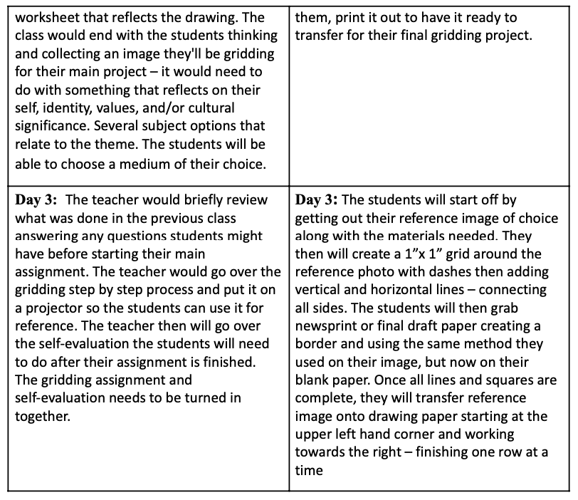
Lesson Plan
Day-by-Day Lesson Plan
Overview
Students will be introduced to the use of the grid method as a means to imprint an image of an artist medium whether it be drawing paper, fabric drawing, a painted canvas, and so on. The student will have an understanding that the grid is a tool used within art to help the artist compose their contour drawing – being used as a visual structure to organize composition, value, and design. It will help the young artists maintain accurate proportions and perspective and learn to focus attention on one small section at a time – replicating what they see as a reference over to the drawing page. Focusing on one square at a time is enough information needed and can also help the young artist not get overwhelmed when seeing the whole picture itself.
Check for Understanding
Students are given exit tickets. i.e. prompt will be on board (how strong do you feel about the topic of the day?) Very strong, in the middle, not strong at all), put response and name on ticket hand to teacher on the way out.
G

Slide 6
Scaffolding
Because students will be studying value piece by piece(grid) on a chosen artwork, it is important to introduce the value scale and have them try it on their own before jumping into the artwork.
I

Slide 7
Instruction Sheet / FAQ
S

Slide 8
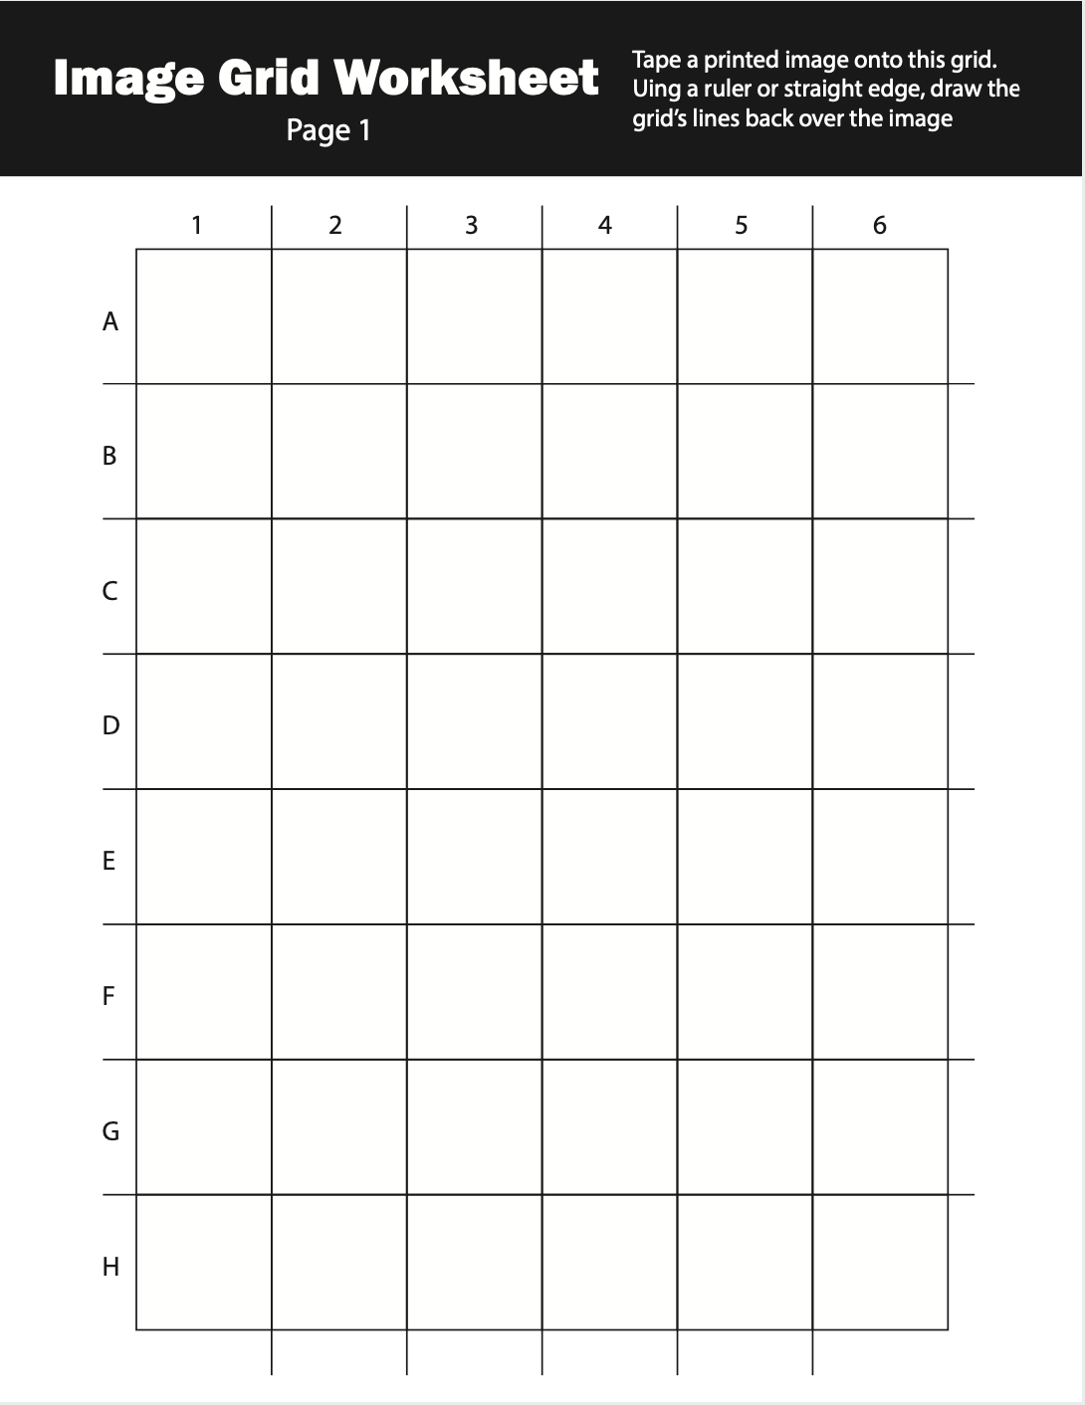
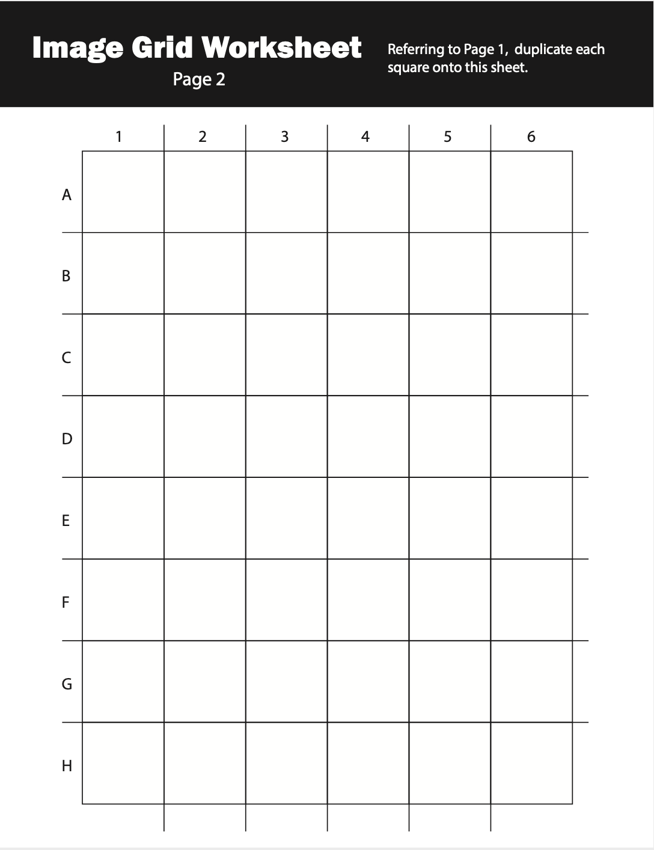
Worksheet
Instructions
Tape a printed image onto this grid. Using a ruler or straight edge, draw the grid lines back over the image.
Referring to Page 1, duplicate each square onto this sheet.
T

Slide 9
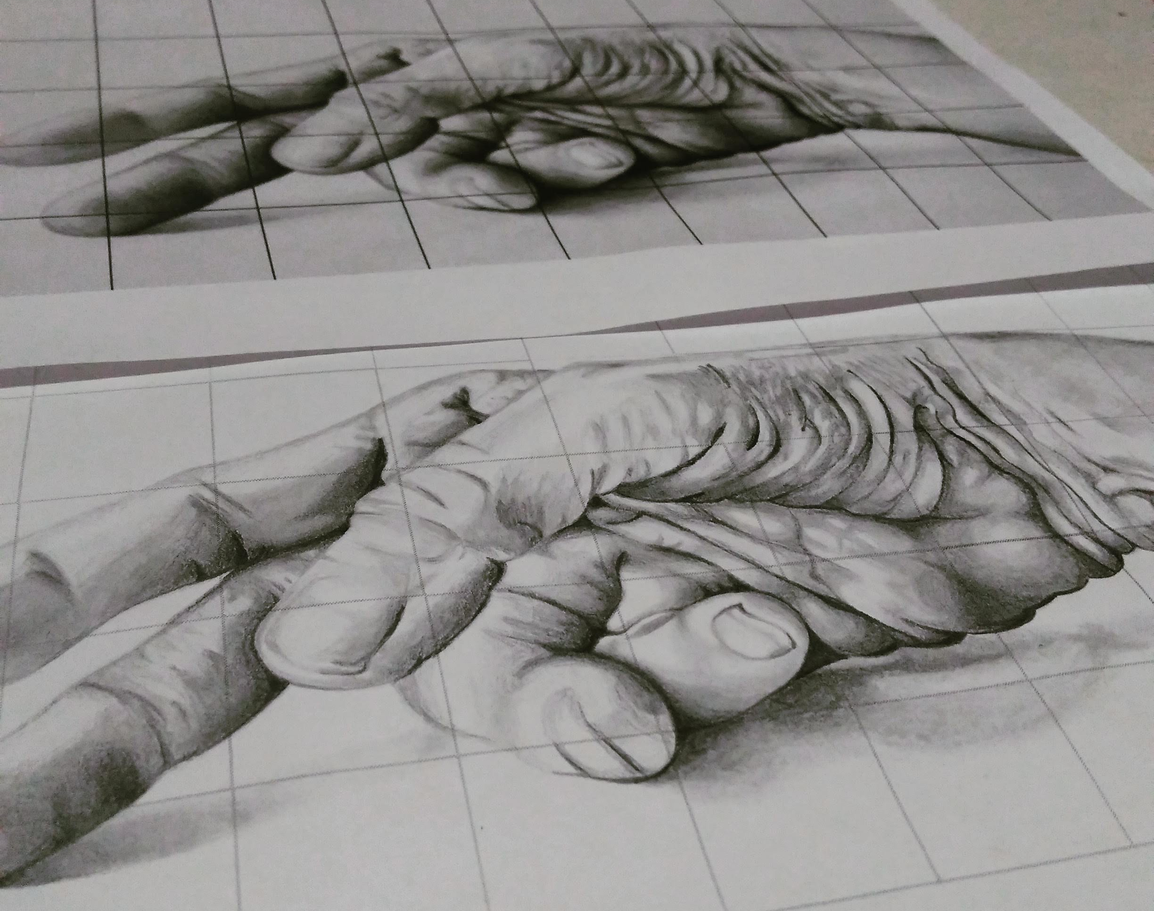
FAQ & Teacher Sample
Reference of grandfather’s hands
Hold a great respect for my elders and family-cultural identity
Importance of hands- create art, tell stories, show love
Hands are what I draw- self-identity
Paid close attention to detail, shading, composition(fingers move the eye in a circular motion)
S / I

Slide 10
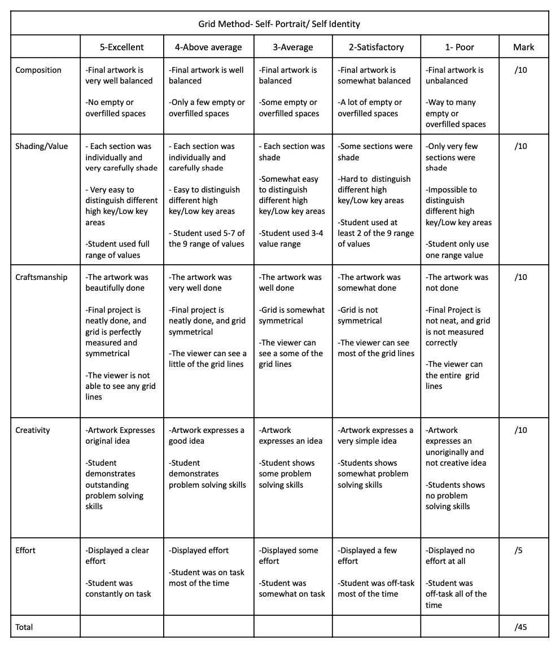
Grading Rubric & Self-Evaluation
Self Evaluation questions:
Do you think your artwork has an interesting and successful composition?
How do you think you did in terms of value and shading?
What do you think is the most successful aspect of your final project?
If you were to do this project again what would you do differently?
Giving your honest opinion, what letter grade do you think you have earned?
L

